Slide 1
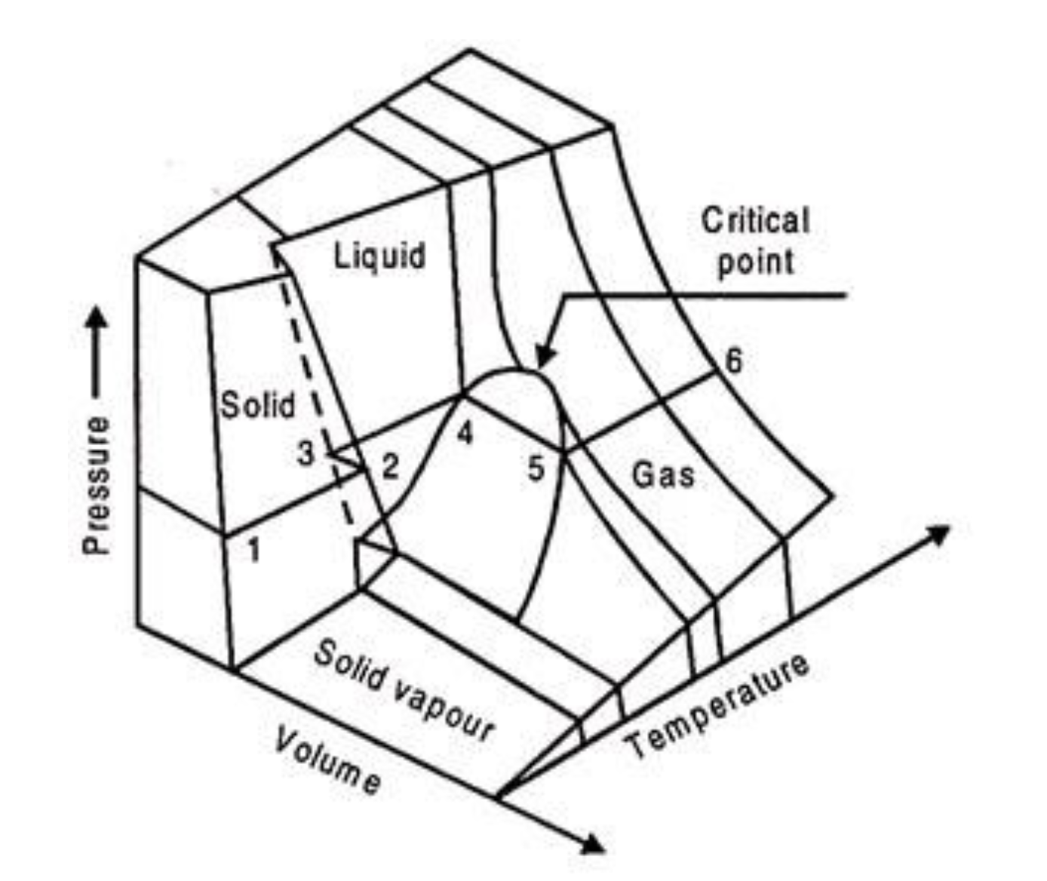
Week 9 – A 3D view of phase diagrams

Slide 2
The kind of question I might ask – Isotherms in phase diagrams
The process at left corresponds to which curve?
Red
Blue
Orange
Green
gas
gas
liquid
liquid
Isothermal compression

Slide 3
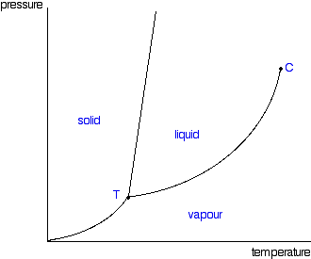


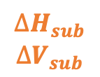
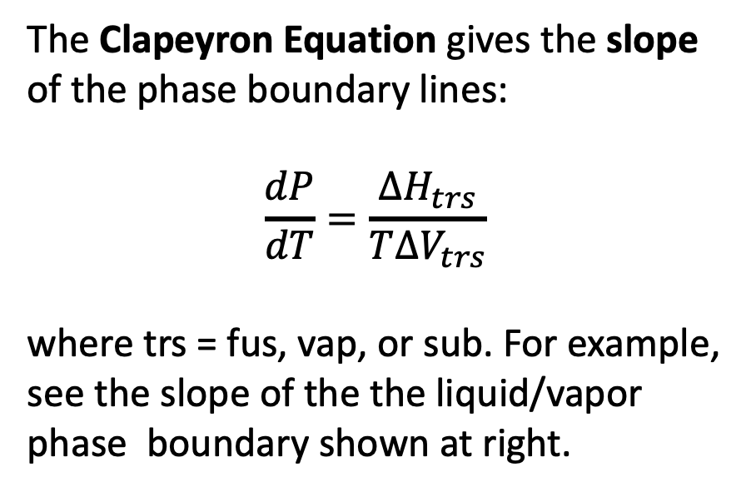
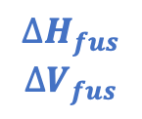


Week 9 – The Clapeyron equation
The Clapeyron Equation gives the slope of the phase boundary lines:
$$\frac{dP}{dT}=\frac{∆H_{trs}}{T∆V_{trs}}$$
where trs = fus, vap, or sub. For example, see the slope of the the liquid/vapor phase boundary shown at right.
$$∆H_{fus}$$
$$∆V_{fus}$$
$$∆H_{vap}$$
$$∆V_{vap}$$
$$∆H_{vap}$$
$$∆V_{vap}$$
$$∆H_{sub}$$
$$∆V_{sub}$$
$$T_{crit}$$
$$T_{crit}$$
$$T_{inv}$$

Slide 4

The kind of question I might ask – Phase diagrams
P
B (line)
Clausius-Clapeyron
Raoult
Thomson
__________
__________
__________
C (line)
D (line)
T

Slide 5
The kind of question I might ask – Phase diagrams
P
B (line)
Clausius-Clapeyron
Raoult
Thomson
Thomson
__________
__________
C (line)
D (line)
T

Slide 6
The kind of question I might ask – Phase diagrams
P
B (line)
Clausius-Clapeyron
Raoult
Thomson
Thomson
Clausius-Clapeyron
__________
C (line)
D (line)
T

Slide 7
The kind of question I might ask – Phase diagrams
P
B (line)
Clausius-Clapeyron
Raoult
Thomson
Thomson
Clausius-Clapeyron
Raoult
C (line)
D (line)
T

Slide 8
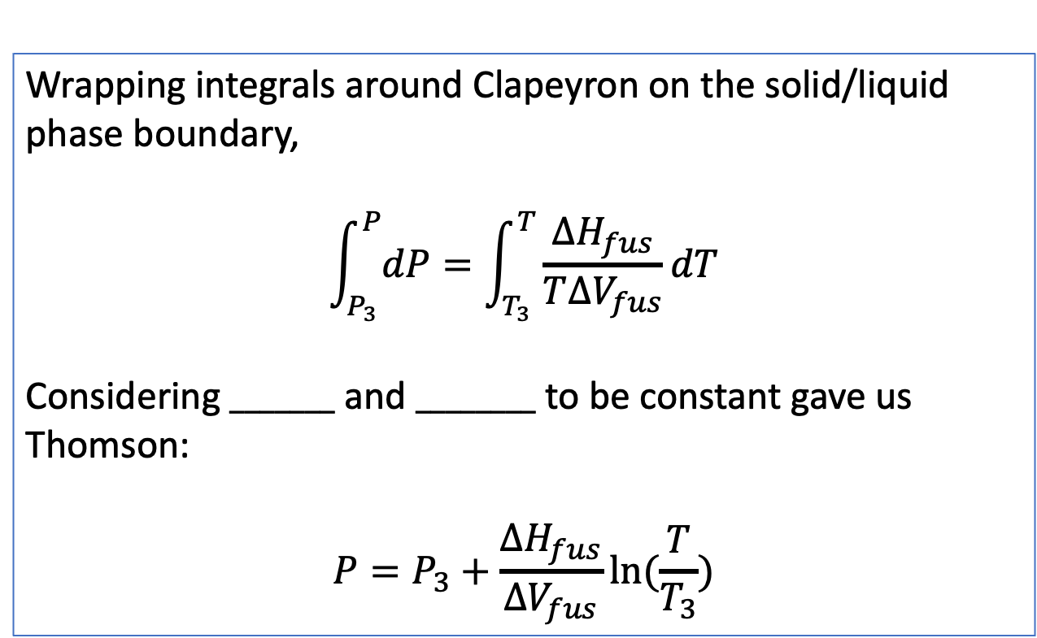
The kind of question I might ask – The Thomson equation
Wrapping integrals around Clapeyron on the solid/liquid phase boundary,
$$\int_{P_{3}}^{P}{dP}=\int_{T_{3}}^{T}{\frac{∆H_{fus}}{T∆V_{fus}}dT}$$
Considering $_______$ and $________$ to be constant gave us Thomson:
$$P=P_{3}+\frac{∆H_{fus}}{∆V_{fus}}ln⁡(\frac{T}{T_{3}})$$
P
T

Slide 9
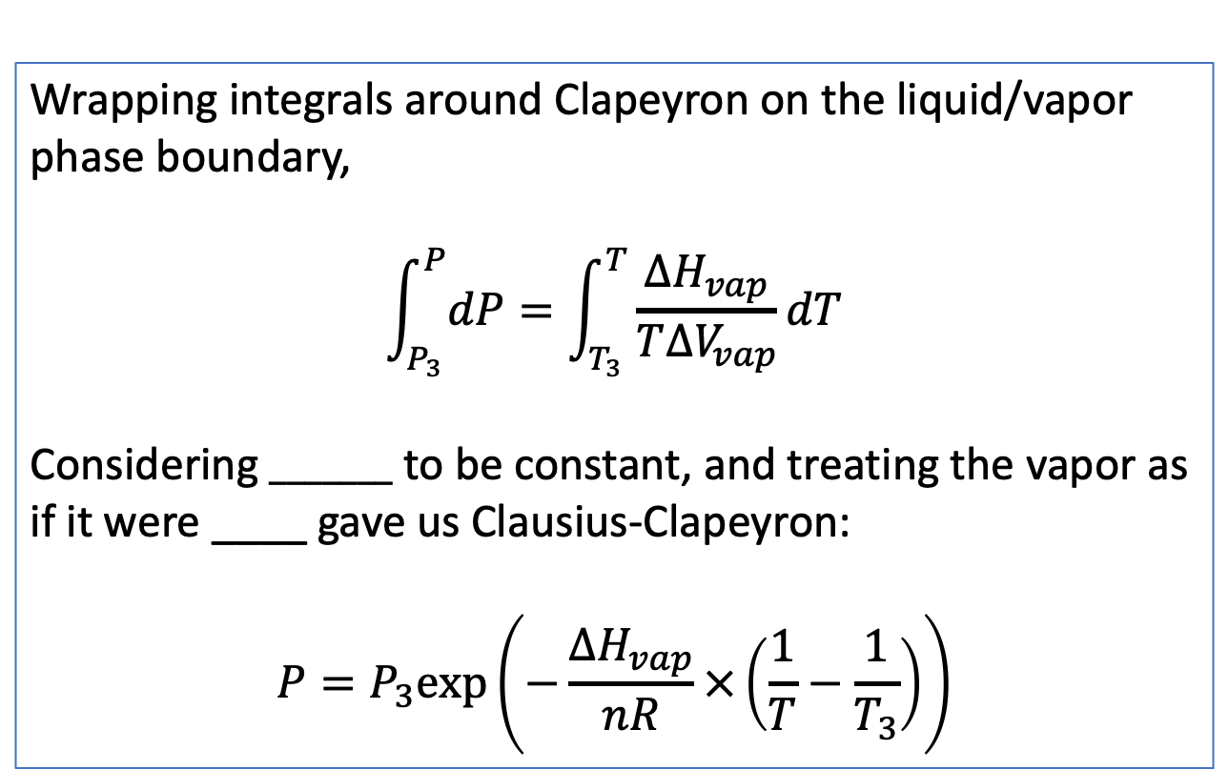
The kind of question I might ask – The Clausius-Clapeyron equation
Wrapping integrals around Clapeyron on the liquid/vapor phase boundary,
$$\int_{P_{3}}^{P}{dP}=\int_{T_{3}}^{T}{\frac{∆H_{vap}}{T∆V_{vap}}dT}$$
Considering $_______$ to be constant, and treating the vapor as if it were ____ gave us Clausius-Clapeyron:
$$P=P_{3}exp⁡\left(−\frac{∆H_{vap}}{nR}×\left(\frac{1}{T}−\frac{1}{T_{3}}\right)\right)$$
P
T

Slide 10



Week 9 – How Raoult’s Law relates $P_{A}$ to $P_{A}^{∗}$
P
A(g)
${P_{A}=P}_{A}^{∗}χ_{A}$
New equilibrium
A
$$P_{A}^{∗}$$
B
A
A
A
A
Solvent A with solute B
B
$$P_{A}$$
A
A
T
Here, $χ_{A}$ is the mole fraction of solvent A in the solution, $χ_{A}≡\frac{n_{A}}{n_{A}+n_{B}}$.

Slide 11




The kind of question I might ask – Isobaric compressibility and isothermal expansivity
$α_{P}≡\frac{1}{V}{\left(\frac{∂V}{∂T}\right)}_{P}$ , $κ_{T}≡−\frac{1}{V}{\left(\frac{∂V}{∂P}\right)}_{T}$
In relation to sea level rise due to climate change, which is the relevant equation for $\frac{∆V}{V}$?
$$∆V$$
$α_{P}∆P$
$α_{P}∆T$
$κ_{T}∆P$
$κ_{T}∆T$
$$V$$

Slide 12
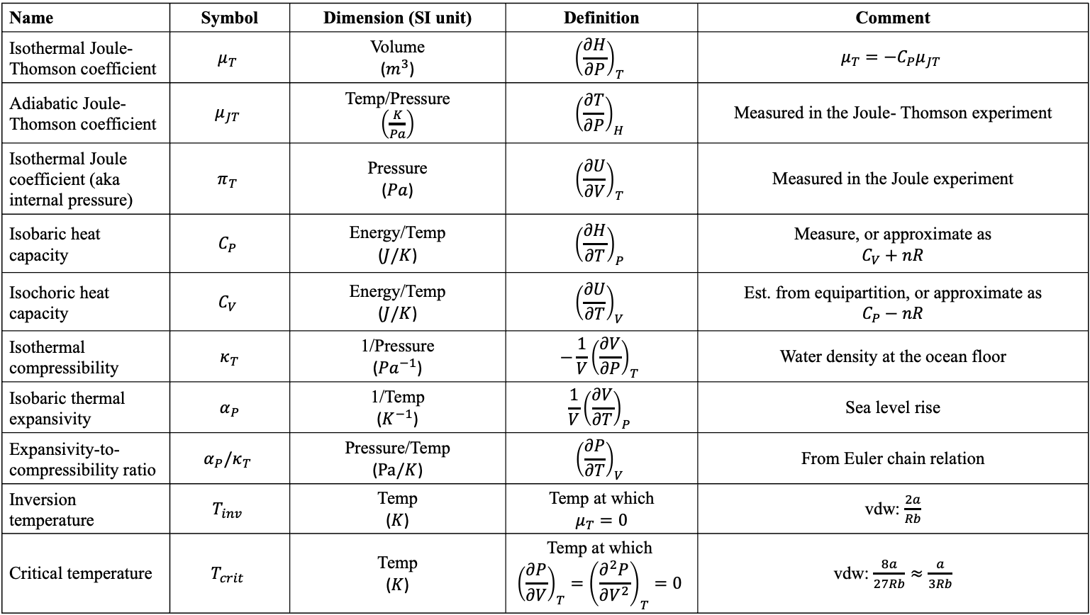
Week 9 – What our measurable quantities include now
Name | Symbol | Dimension (SI unit) | Definition | Comment
Isothermal Joule-Thomson coefficient | $$μ_{T}$$ | Volume ($m^{3}$) | $${\left(\frac{∂H}{∂P}\right)}_{T}$$ | $$μ_{T}=−C_{P}μ_{JT}$$
Adiabatic Joule-Thomson coefficient | $$μ_{JT}$$ | Temp/Pressure $\left(\frac{K}{Pa}\right)$ | $${\left(\frac{∂T}{∂P}\right)}_{H}$$ | Measured in the Joule- Thomson experiment
Isothermal Joule coefficient (aka internal pressure) | $$π_{T}$$ | Pressure ($Pa$) | $${\left(\frac{∂U}{∂V}\right)}_{T}$$ | Measured in the Joule experiment
Isobaric heat capacity | $$C_{P}$$ | Energy/Temp ($J/K$) | $${\left(\frac{∂H}{∂T}\right)}_{P}$$ | Measure, or approximate as $$C_{V}+nR$$
Isochoric heat capacity | $$C_{V}$$ | Energy/Temp ($J/K$) | $${\left(\frac{∂U}{∂T}\right)}_{V}$$ | Est. from equipartition, or approximate as $$C_{P}−nR$$
Isothermal compressibility | $κ_{T}$ | 1/Pressure (${Pa}^{−1}$) | $$−\frac{1}{V}{\left(\frac{∂V}{∂P}\right)}_{T}$$ | Water density at the ocean floor
Isobaric thermal expansivity | $α_{P}$ | 1/Temp ($K^{−1}$) | $$\frac{1}{V}{\left(\frac{∂V}{∂T}\right)}_{P}$$ | Sea level rise
Expansivity-to-compressibility ratio | $$α_{P}/κ_{T}$$ | Pressure/Temp ($Pa/K$) | $${\left(\frac{∂P}{∂T}\right)}_{V}$$ | From Euler chain relation
Inversion temperature | $$T_{inv}$$ | Temp ($K$) | Temp at which $$μ_{T}=0$$ | vdw: $\frac{2a}{Rb}$
Critical temperature | $$T_{crit}$$ | Temp ($K$) | Temp at which $${\left(\frac{∂P}{∂V}\right)}_{T}={\left(\frac{∂^{2}P}{∂V^{2}}\right)}_{T}=0$$ | vdw: $\frac{8a}{27Rb}≈\frac{a}{3Rb}$

